Slide 1
Professional Development Series
Fall 2022

Slide 2
Table of Contents
Writing Center
University Libraries
UNT Career Center
Toulouse Graduate School
Counseling and Testing Services
Responsible Conduct of Research
Office of Research and Consulting
Student Money Management Center

Slide 3
Writing Center
Academic Writing for International Students
Tuesday, September 13 at Noon
Understanding Plagiarism
Tuesday, October 11 at Noon
Academic Writing Style
Tuesday, October 18 at Noon
Writing the Literature Review
Tuesday, November 15 at Noon
Preparing Materials for The Academic Job
Tuesday, November 29 at Noon

Slide 4
UNT Libraries
Introduction to RefWorks
Thursday, September 15 at 10:00 am
Interlibrary Loan and Document Delivery
Thursday, September 22 at 2:00 pm
What the Libraries Can Do for YOU
Thursday, October 6 at 2:00 pm
Mindful Study Break
Friday, December 9 at 2:00 pm
Monday, December 12 at 5:00 pm

Slide 5
UNT Career Center
Resume Workshop for Graduate Students
Tuesday, September 20 at 3:30 pm
Networking and Personal Branding Workshop for Graduate Students
Tuesday, October 18 at 3:30 pm
Curriculum Vitae (CV) Workshop
Tuesday, November 8 at 3:30 pm

Slide 6
Toulouse Graduate School
3MT Informational Workshop
Tuesday, September 27 at 3:30 pm
3MT Prep Workshop
Wednesday, October 12 at 2:30 pm
Student Success for International Students
Tuesday, September 13 at 10:00 am
How to Write a Winning Grant Proposal
Monday, September 28 at 3:00 pm
Eagle Thesis Dissertation Boot Camp
September 28, 29, 30 at 8:30 am
October 28, 29, 30 at 8:30 am
November 16, 17, 18 at 8:30 am

Slide 7
Counseling and Testing Services
G.R.I.T / Overview of CTS Services
Wednesday, September 28 at 3:00 pm
Strengths and Style
Wednesday, October 19 at 3:00 pm
Collaborative Learning
Wednesday, October 26 at 3:00 pm
Imposter Syndrome
Wednesday, November 16 at 3:00 pm
Thriving in Grad School
Bi-Weekly starting September 8 at 3:00 pm

Slide 8
Responsible Conduct of Research
IRB- Human Subjects Research
Tuesday, September 13 at 2:00 pm
COI- Conflict of Interest
Tuesday, September 27 at 2:00 pm
Biosafety
Tuesday, October 25 at 2:00 pm
International Affiliations
Tuesday, November 29 at 2:00 pm

Slide 9
Office of Research and Consulting
ORC Speaker Series
Moving From SPSS to R (4 Part Series)
Wednesday, September 14 at 4:00 pm
Wednesday, September 21 at 4:00 pm
Wednesday, September 28 at 4:00 pm
Wednesday, October 5 at 4:00 pm
Qualitative Research Methods (3 Part Series)
Wednesday, October 12 at 4:00 pm
Wednesday, October 19 at 4:00 pm
Wednesday, October 26 at 4:00 pm
How to Implement Qualtrics (3 Part Series)
Thursday, November 3 at 4:00 pm
Thursday, November 10 at 4:00 pm
Thursday, November 17 at 4:00 pm

Slide 10
Student Money Management Center
Financial Intelligence Training (FIT) Series
Tuesday, October 10 at 2:00 pm
Tuesday, October 18 at 2:00 pm
Tuesday, October 25 at 2:00 pm
Eagle Take Off Talk: Salary Negotiations
Wednesday, October 19 at 1:30 pm
Fall Cash Festival
Monday, October 3 through Friday, October 7
Financial Wellness Coaching
Ongoing

Slide 11
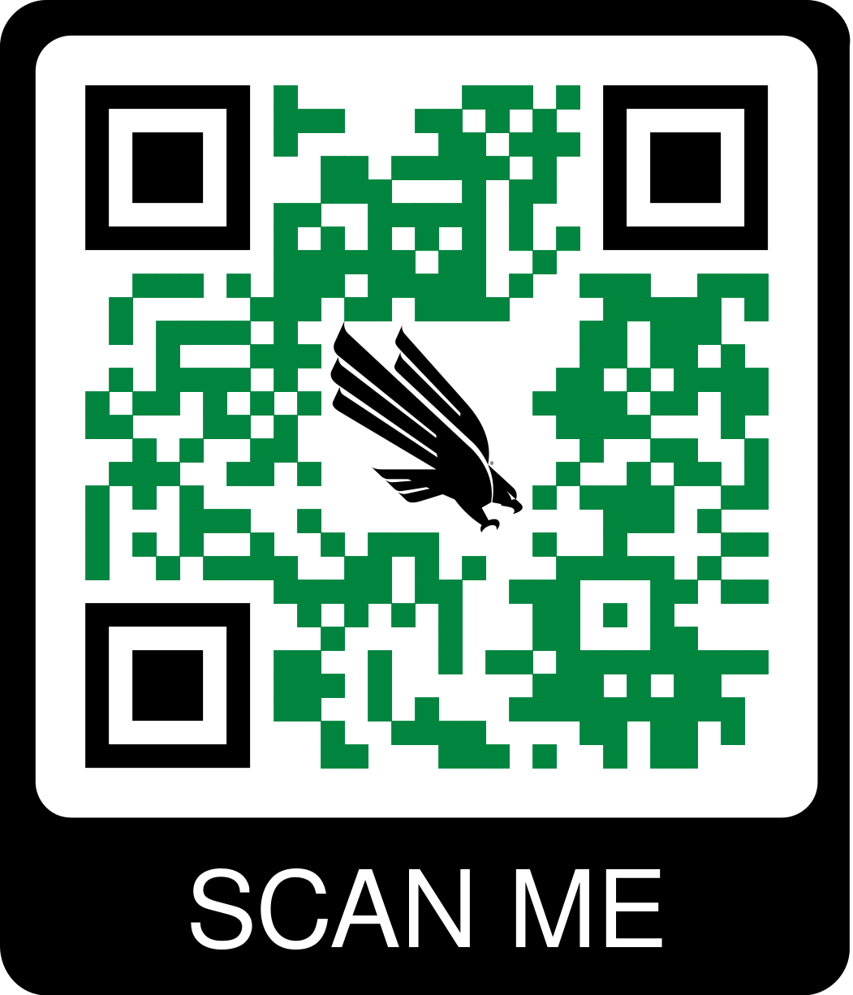
Upcoming Workshops
These events and more are found on the Toulouse Graduate School’s event calendar.
Please visit often.

Slide 12
Thank you!

