Slide 1
Confidence and Power in Statistics II
Office of Research Consulting
https://coe.unt.edu/research/research-consulting
COE-ORC@unt.edu
(940) 565-4414
Lee Bedford and Mehri Mizaeirafe
October 17, 2019 2:00 PM

Slide 2
Outline
Null Hypothesis Significance Testing
Statistical Significance
Practical Significance
Power
Sample Size
Effect Size
Alpha
One-tailed vs Two-tailed
Decision Errors
Statistical Models

Slide 3
Two Types of Statistics
Descriptive
Middle of the Distribution
Mean, Median, and Mode
Spread of the Distribution
Variance and Standard Deviation
Shape of the Distribution
Normal, Skewness, Kurtosis
Inferential
Null Hypothesis Significance Testing
Notes:
Start at 2:55 PM
Audience participation: what is an inference?

Slide 4
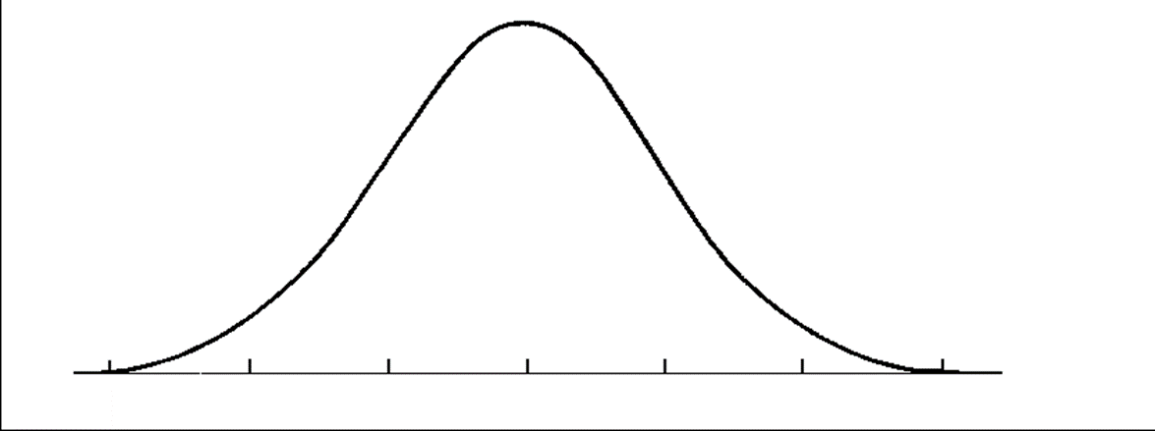
Normal Curve
Most variables psychologists study have distributions that are approximately normal
Characteristics:
Unimodal
Symmetrical
Bell-shaped

Slide 5
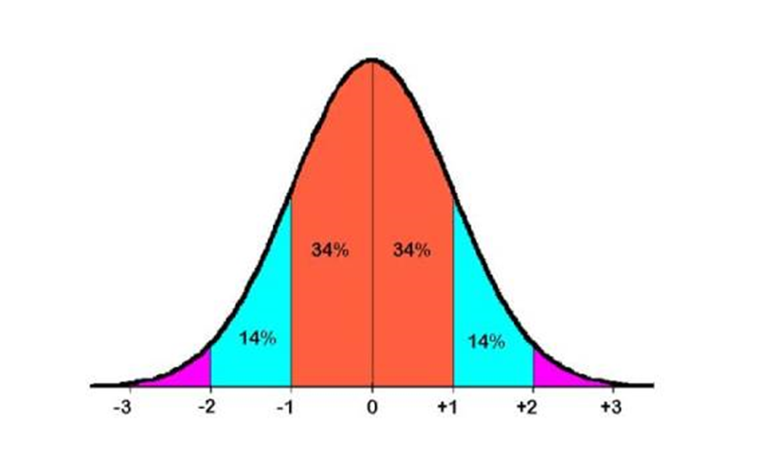
Normal Curve
Shape of normal curve is standard
We can estimate the percentage of scores above or below a particular point

Slide 6
Logic of Hypothesis Testing
Hypothesis Testing
A systematic procedure for deciding whether the results of a study (using a sample) support a particular theory (and applies to a certain population)
Theory
More general set of principles that explain one or more facts, relationships, or events
Hypothesis
Specific prediction that is tested in a study

Slide 7
Logic of Hypothesis Testing
Hypothesis testing works by calculating the probability that the result we get is due to chance
If this probability is very low, we:
Reject the idea that our “experiment” had no effect (reject the null hypothesis)
If this probability is very high, we:
Fail to reject the idea that our “experiment” had no effect (fail to reject the null hypothesis)

Slide 8
5 Steps of Hypothesis Testing
State the Null Hypothesis and Research Hypothesis about the populations
Determine the Characteristics of the Comparison Distribution
Determine the Cutoff Sample Score on Comparison Distribution where Null Hypothesis Should be Rejected
Determine Your Sample’s Score on the Comparison Distribution
Decide Whether to Reject the Null Hypothesis
**Save room for a Step 0 and a Step 5.5**

Slide 9
Example
Theory: Watching Parks and Recreation increases happiness.
Hypothesis: People who watch Parks and Rec for 30 minutes per day are happier than people who do not watch Parks and Rec.

Slide 10
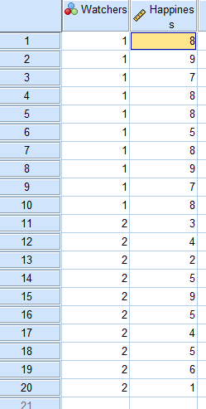
2 Samples of People
We compared 10 people who
watch Parks and Rec for 30
minutes per day to 10 people
who do not watch Parks and Rec.
Total N = 20

Slide 11
State the Null Hypothesis and Research Hypothesis about the populations
(Step 1)
Null Hypothesis:
Research Hypothesis:

Slide 12
State the Null Hypothesis and Research Hypothesis about the populations
(Step 1)
Null Hypothesis: People who watch Parks and Rec for 30 minutes per day are not happier than people who do not watch Parks and Rec.
Research Hypothesis: People who watch Parks and Rec for 30 minutes per day are happier than people who do not watch Parks and Rec.

Slide 13
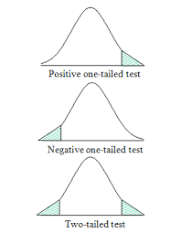
Determine the Characteristics of the Comparison Distribution
(Step 2)

Slide 14
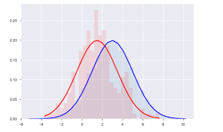
Determine the Cutoff Sample Score on Comparison Distribution where Null Hypothesis Should be Rejected
(Step 3)
Sample 1 df (n-1) = 9
Sample 2 df (n-1) = 9
Total df = 18
Cutoff score =

Slide 15
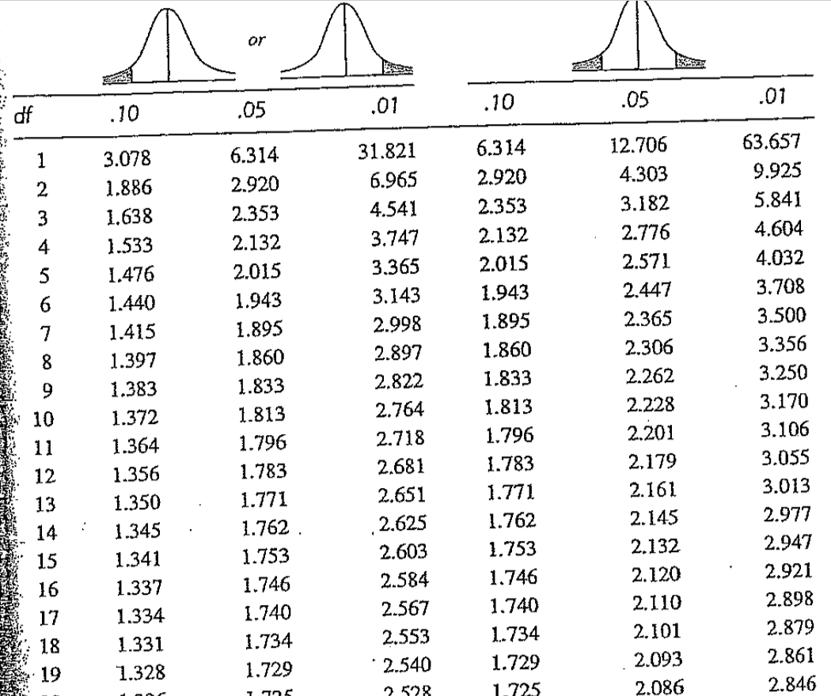

Slide 16
Determine the Cutoff Sample Score on Comparison Distribution where Null Hypothesis Should be Rejected
(Step 3)
Sample 1 df (n-1) = 9
Sample 2 df (n-1) = 9
Total df = 18
Cutoff score = 1.734

Slide 17
Determine Your Sample’s Score on the Comparison Distribution
(Step 4)
t = (M₁ – M₂) / SD_{difference}
SD²_{Difference} = SD²_{M1} + SD²_{M2}
SD²_{M1} = SD²_{Pooled} / N₁
SD²_{M2} = SD²_{Pooled} / N₂
SD²_{Pooled} = (df₁/df_{Total})(SD²₁) + (df₂/df_{Total})(SD²₂)
SD² = ∑ (X – M)² / (N – 1)
df_{Total} = df₁ + df₂
d = (M₁ – M₂)/SD_{pooled}

Slide 18
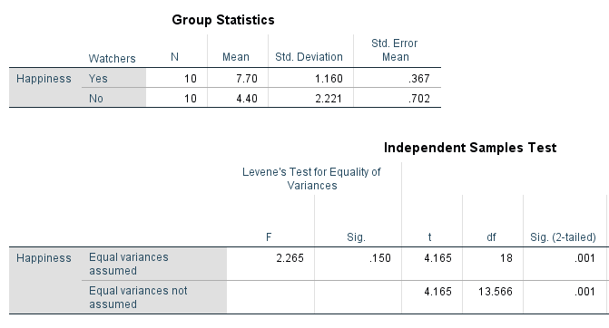
SPSS Output
t(18) = 4.165

Slide 19
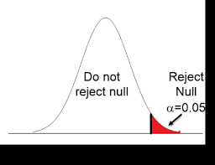
Decide Whether to Reject the Null Hypothesis
(Step 5)
Cutoff score = 1.734
t(18) = 4.165
Reject the Null!!

Slide 20
SPSS Output
Sig. (2-tailed) is the same as p–value for a two tailed test

Slide 21
5 Steps of Hypothesis Testing
State the Null Hypothesis and Research Hypothesis about the populations
Determine the Characteristics of the Comparison Distribution
Determine the Cutoff Sample Score on Comparison Distribution where Null Hypothesis Should be Rejected
Determine Your Sample’s Score on the Comparison Distribution
Decide Whether to Reject the Null Hypothesis
**Save room for a Step 0 and a Step 5.5**

Slide 22
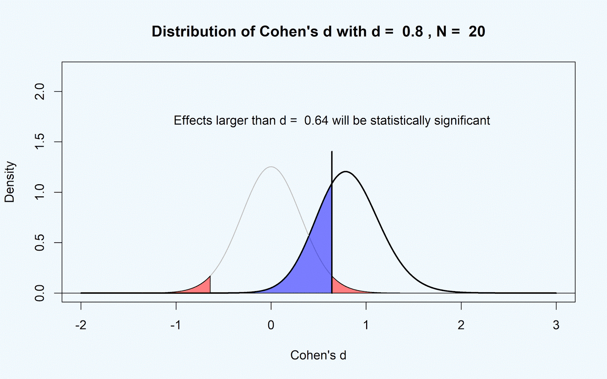
Practical Significance
(Step 5.5)
Effect size: The distance between the means of the two samples

Slide 23
Effect Size for t-Test for Independent Means
Cohen’s d
d = (M₁ – M₂)/SD_{pooled}
d = Cohen’s d (effect size)
M₁ = mean of sample 1
M₂ = mean of sample 2
SD_{pooled} = pooled estimate of the population’s standard deviation
d = 1.86

Slide 24
Power
The ability to detect an effect if there really is an effect.
80-100%
Power is influenced by:
Sample size
Effect Size
Alpha (Significance level)
One-tailed vs Two-tailed tests

Slide 25
How to Increase Power?
Increase sample size
Increase effect size
***Do not change significance level or choose test type (One-tailed vs Two-tailed) to increase power!

Slide 26
Decision Errors
When you make an incorrect decision in hypothesis testing
E.g., Rejecting the null hypothesis when you should not
Even if you do everything right, there is still a 5% chance of making an error

Slide 27
Type I Error
Reject the null hypothesis when it is in fact true
Conclude that the study supports the research hypothesis when it is false
We could, by chance, happen to sample an especially happy group of people
Based on the results of our study, we reject the null hypothesis even though we should not have

Slide 28
Type II Error
Not rejecting the null hypothesis when it is in fact false
Conclude that the results of the study are inconclusive when the research hypothesis is true

Slide 29
Decision Errors
Trade-off between Type I and Type II Errors:
If you make your significance level more strict (e.g., p < .001), you are less likely to make a _________ Error but more likely to make a ______ Error
If you make your significance level more lenient (e.g., p < .10), you are less likely to make a _____ Error but more likely to make a _____ Error.

Slide 30
Decision Errors
Researchers usually make a compromise
Standard significance levels
p < .05
p < .01

Slide 31
Statistical Models
(See Handout)
Categorical Variables
Dichotomous Variables
Continuous Variables

Slide 32
Statistical Models
(See Handout)
Independent Variables
Dependent Variables

Slide 33
Statistical Models
(See Handout)
Categorical Variables
Dichotomous Variables
Continuous Variables

Slide 34
Types of Hypotheses
(See Handout)
Are there differences between groups?
Do the IVs predict the DVs?
Does my data fit the model?

Slide 35
Thank You.
Lee Bedford and Mehri Mizaeirafe
https://coe.unt.edu/research/research-consulting
COE-ORC@unt.edu
(940) 565-4414

